Slide 1
DEVELOPER RESOURCES

Slide 2
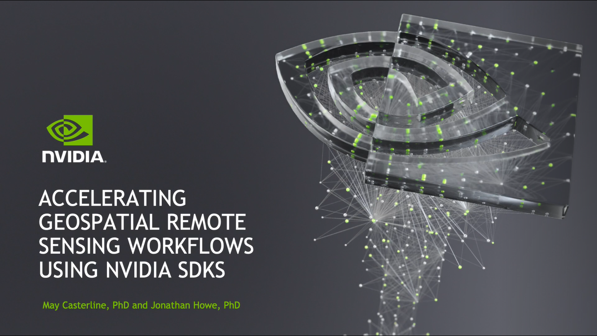
Accelerating Geospatial remote sensing workflows
GTC Session Recorded Here

Slide 3
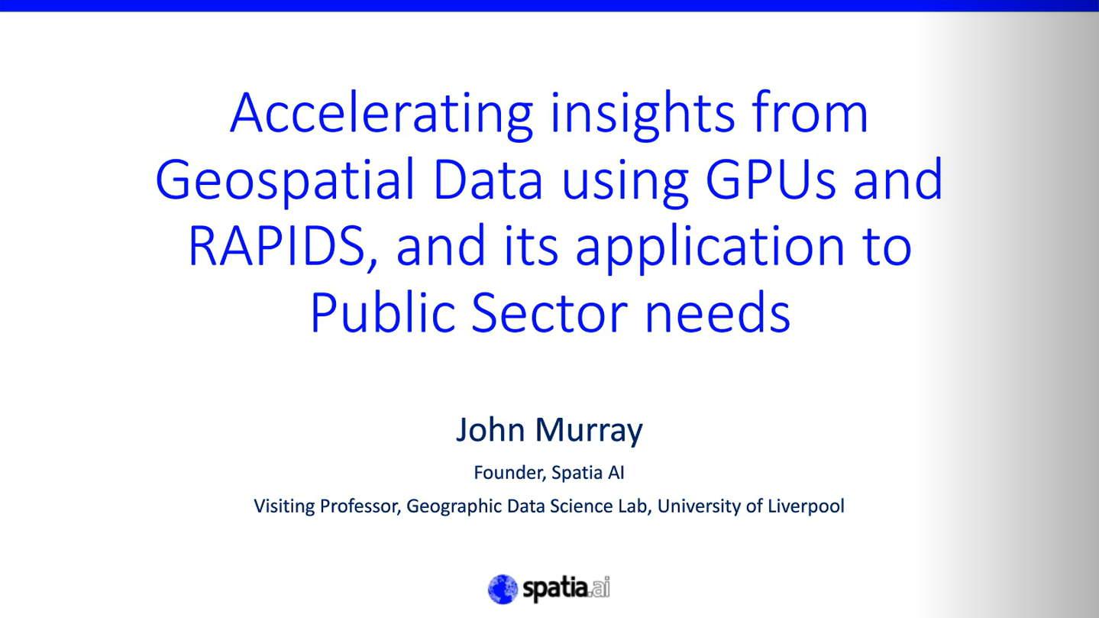
Accelerating insights from geospatial data using gpus and rapids, and its application to public section use
GTC Session Recorded Here and PPT Linked Here

Slide 4


Radiant earth foundation
Focused on Applying Machine Learning for Earth Observation to Meet the Sustainable Development Goals – the World’s Most Critical Challenges
Radiant Earth focuses on three key strategic goals:
Fostering an open source “Hub” to discover and access EO training datasets and ML models;
Cultivating a community of practice to develop standards around ML on EO and to expand the interoperability of these tools and datasets; and
Raising awareness amongst global development actors, data scientists, and geospatial professionals on the progress and innovation in the ML and EO marketplace.
Links
Main Website: Radiant Earth Foundation – Earth Imagery for Impact
Radiant MLHub: Radiant MLHub — Open Geospatial ML Library

Slide 5

The environmental data science book
Showcase and Support the Publication of Data, Research and Open-source Tools Using Data Science and AI for Monitoring and Modelling a Wide Diversity of Environmental Systems
The Environmental Data Science is:
a book
a community
a global collaboration
We target to make sense of:
environmental systems
environmental data and sensors
innovative research in Environmental Data Science
open-source tools for Environmental Data Science

Slide 6
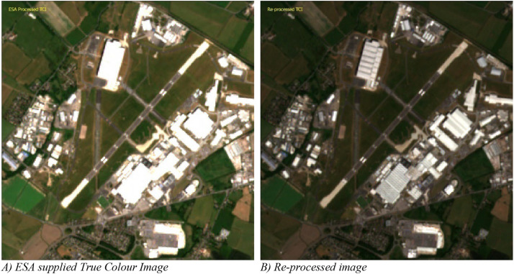
Estimating generalized measures of local neighborhood context from multispectral satellite images using a convolutional neural network
Paper: Estimating generalized measures of local neighbourhood context from multispectral satellite images using a convolutional neural network
GitHub: GDSL-UL/sat_cnn
Using Data from Harvard Dataverse

